Slide 1
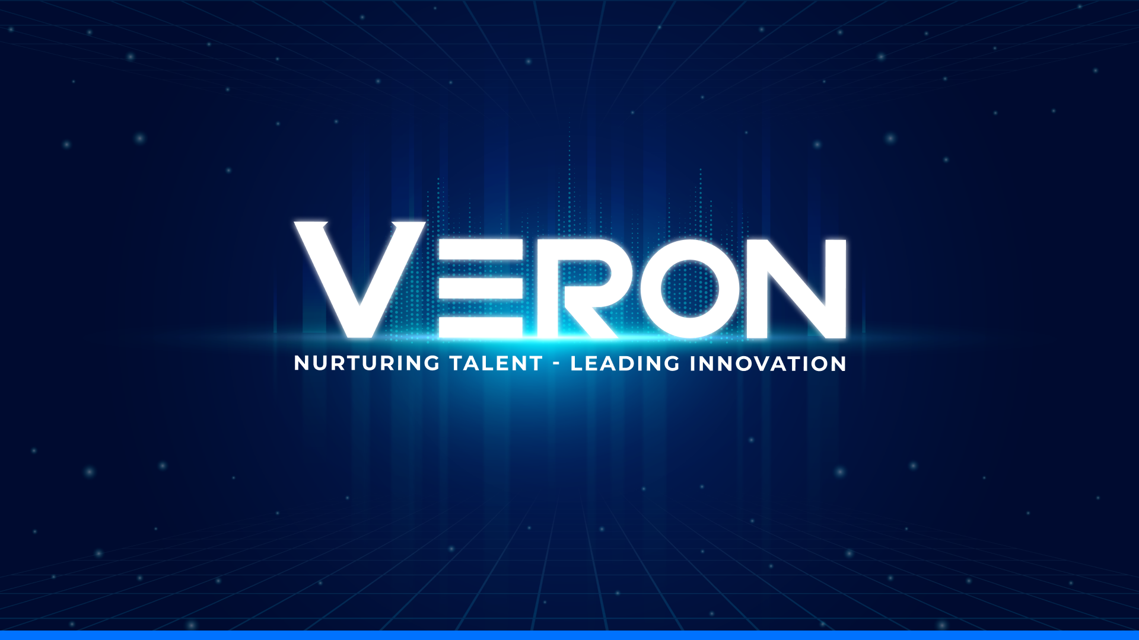

Slide 2

VERON R&D
AI SEMICONDUCTOR

Slide 3

Content About VERON R&D Our Technologies Our Abilities Our Solutions Our Experts Our Experience Our Partners

Slide 4
About VERON R&D
VERON R&D, a subsidiary of VERON Group, is a semiconductor technology company specializing in comprehensive hardware solutions, including analog and digital circuit design. Building on this foundation, VERON R&D leads the way in semiconductor-based solutions and applications, such as Edge AI on FPGA, AI chips, and SBCs.

Slide 5
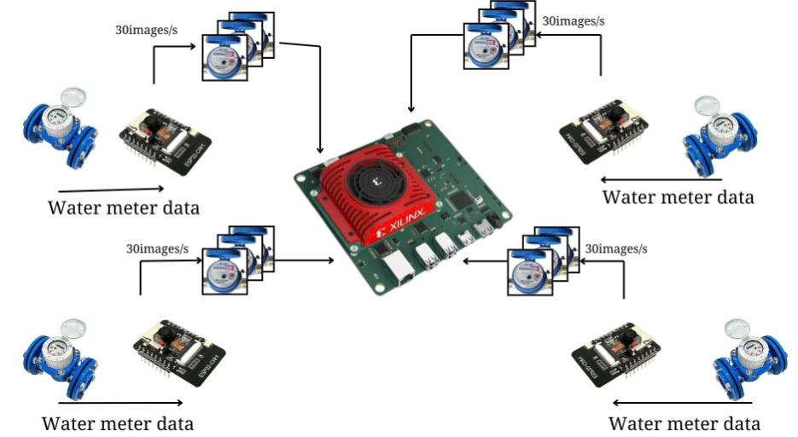
Our Technologies
1. FPGA DPU Edge AI
Flexible configuration
Allows for the optimization of AI circuit performance
Simultaneously handling multiple task in real time
Customize models through SDK

Slide 6
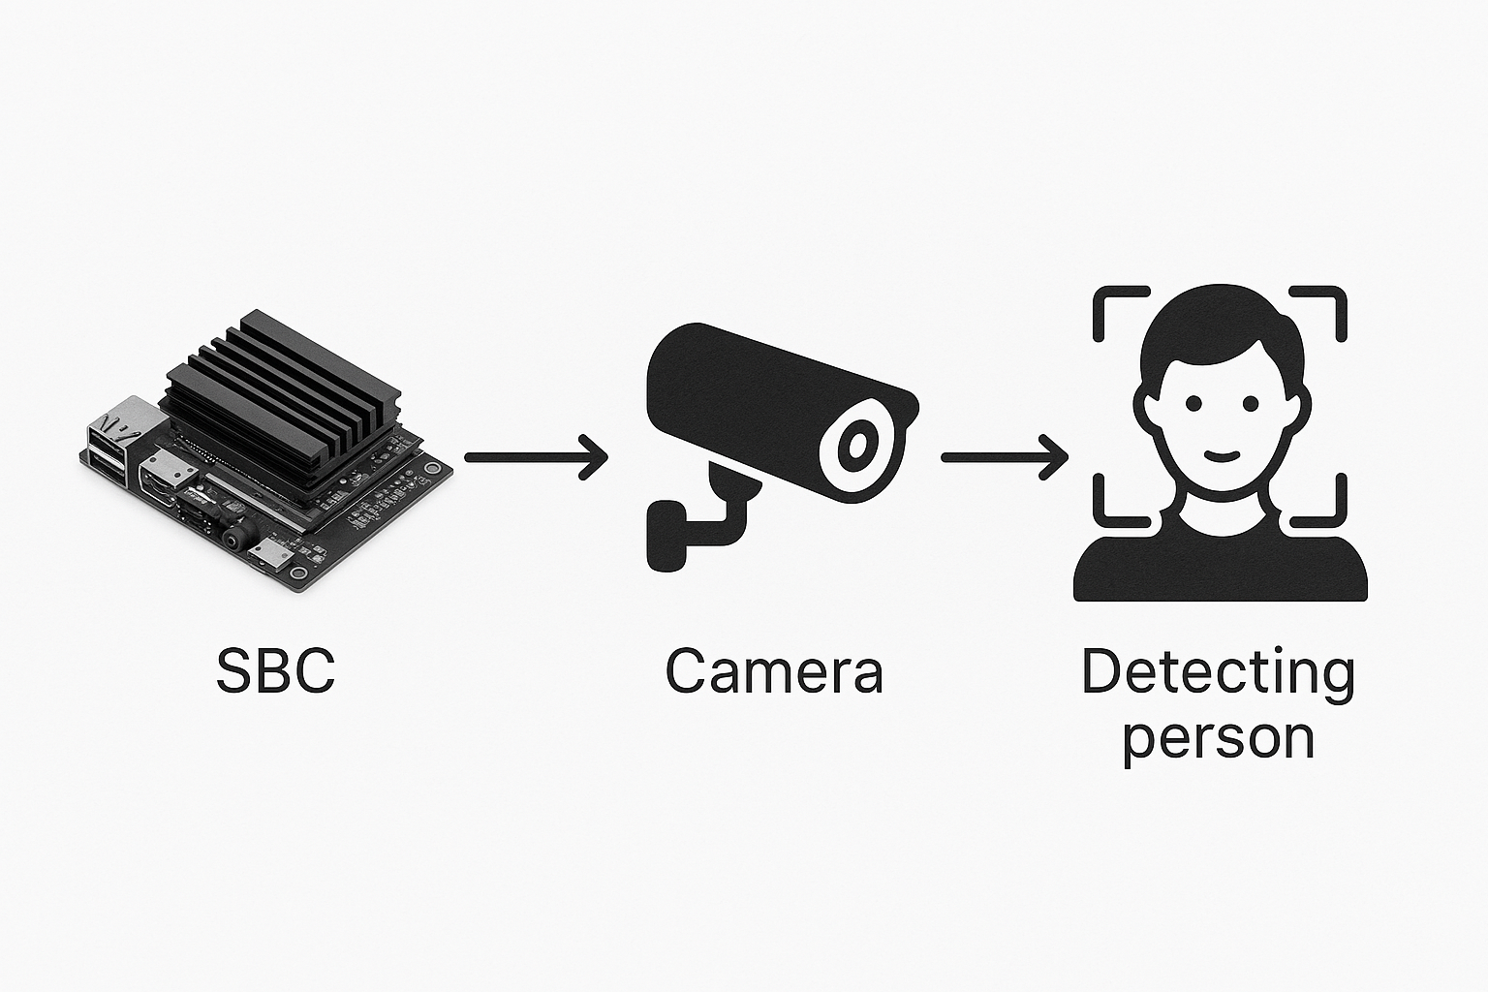
Our Technologies
2. SBC Edge AI
On-site AI processing with rapid response ability
Independent task execution
Compact, cost-effective and swift deployment

Slide 7
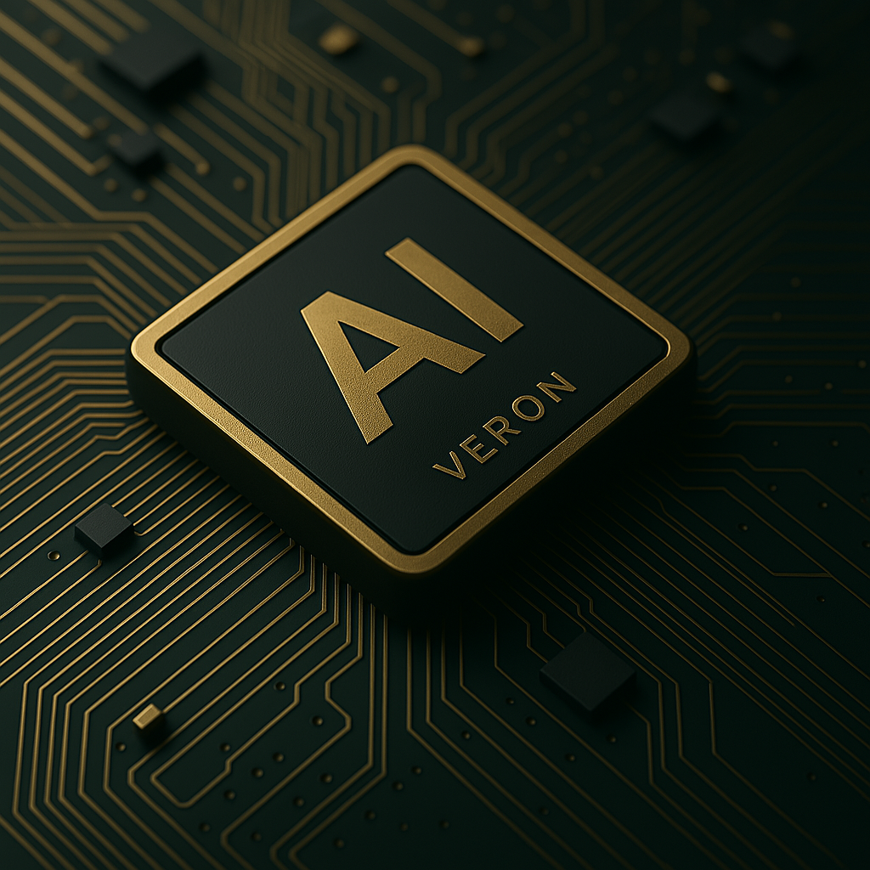
Our Technologies
3. AI Chip
Exceptional performance in executing AI algorithms
Rapid, low-latency inference for complex neural networks
Optimal operation even in power-constrained environment

Slide 8
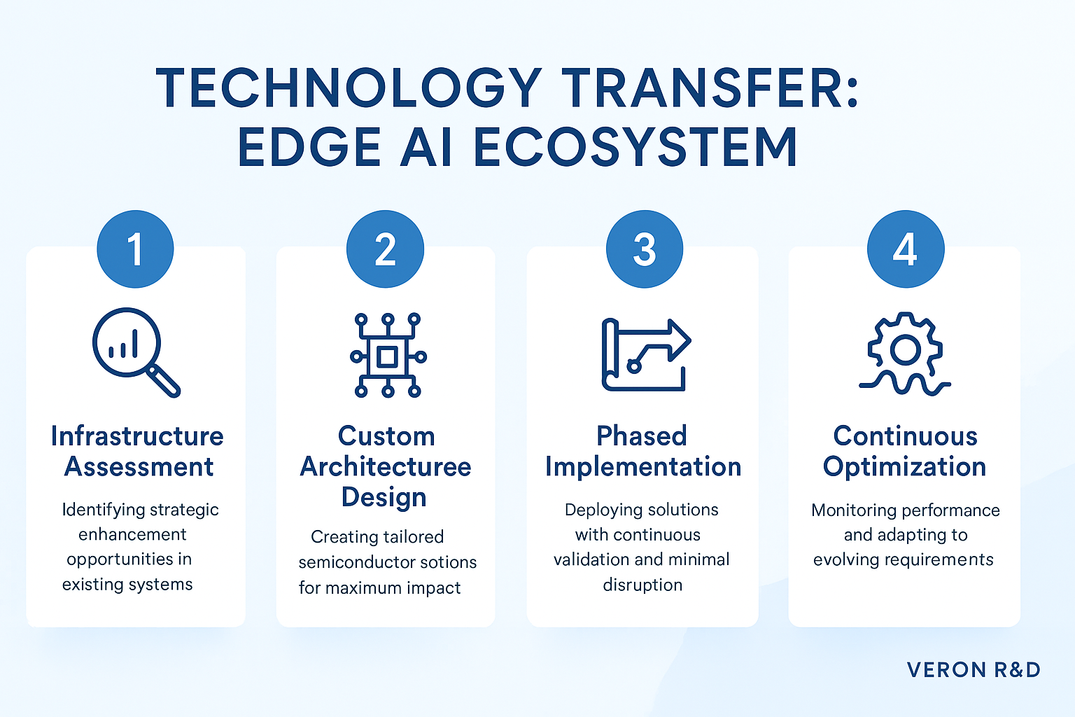
Our Abilities
1. Technology Transfer

Slide 9
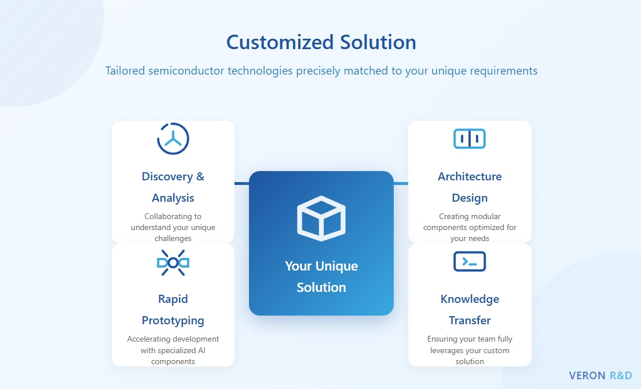
Our Abilities
2. Customized Solution

Slide 10
Our Abilities
3. Customized AI Model
2.1. Unet - Image segmentation/classification 2.2. Yolo - Object detection 2.3. Diffusion model - Generative AI 2.4. EfficientNet - Image classification 2.5. DenseNet - Image segmentation/classification 2.6. Natural Language Processing model | 2.7. Vision Language Model 2.8. Resnet-Unet-Hybrid 2.9. Unet with attention gate - dental segmentation 2.10. Variational Auto-Encoder 2.11. Long short-term memory

Slide 11
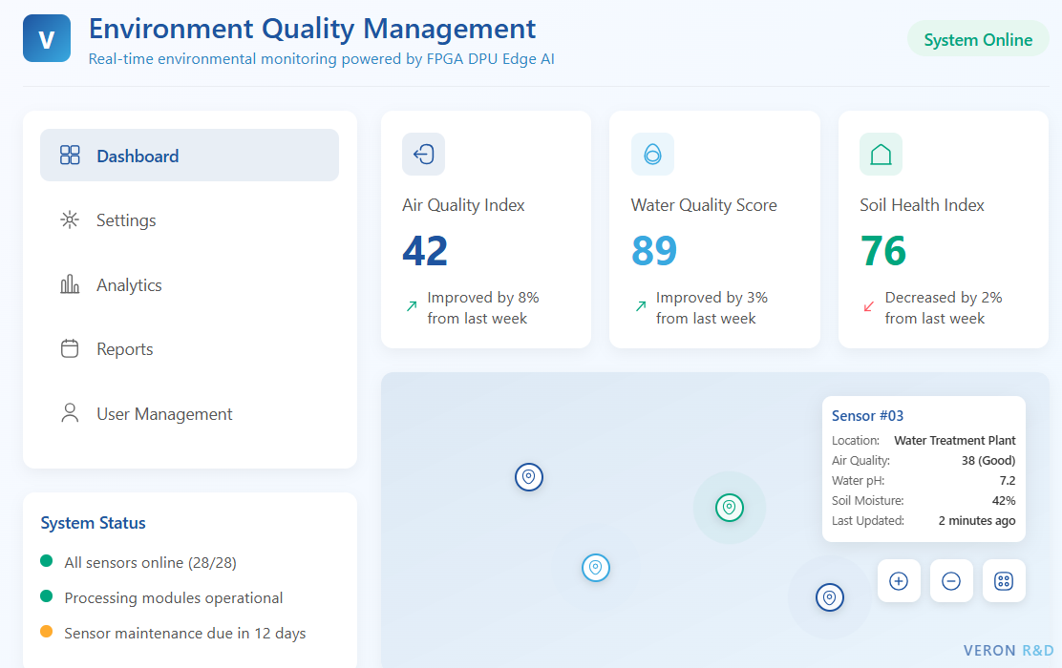
Our Solutions
1. Environment quality smart managment
Distributed Edge AI enables real-time environmental monitoring.
Local processing minimizes bandwidth and detects anomalies.
Analytics engine converts raw data into proactive insights.
Customizable interface supports compliant reporting and integration.

Slide 12
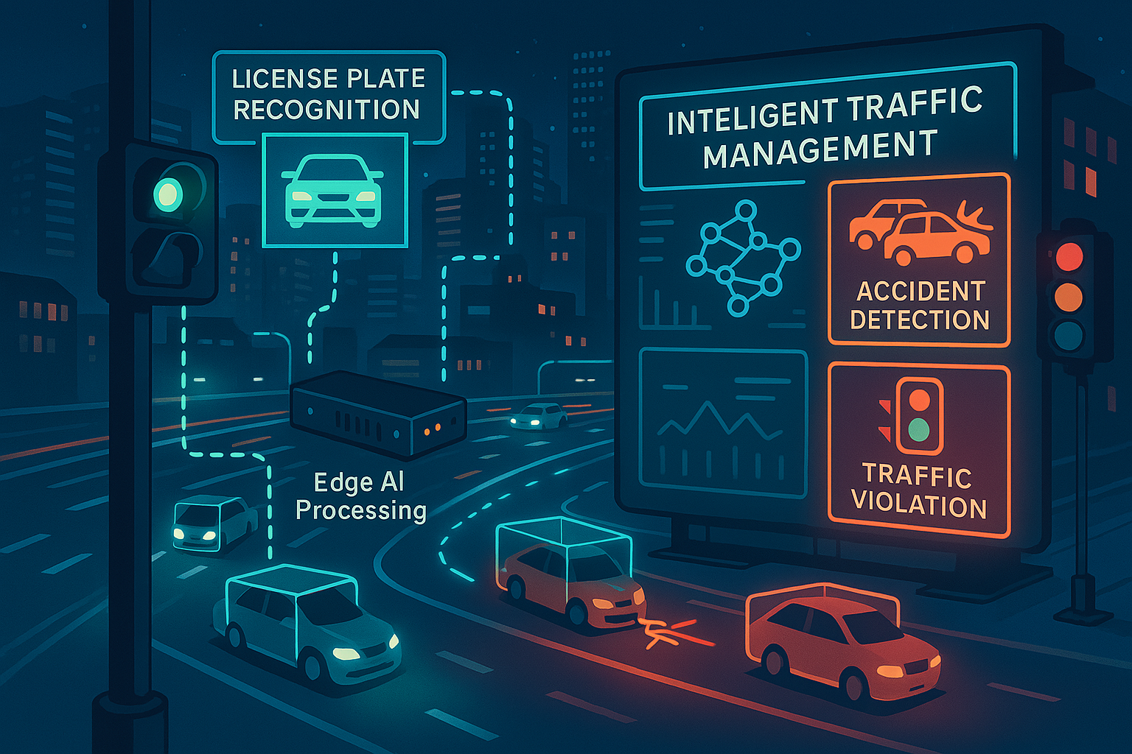
Our Solutions
2. Traffic smart management
Semiconductor-based AI powers intelligent traffic control.
Distributed Edge AI monitors traffic via video feeds.
Adaptive machine learning optimizes signals and predicts incidents.
Unified platform integrates navigation, transit, and insights.

Slide 13
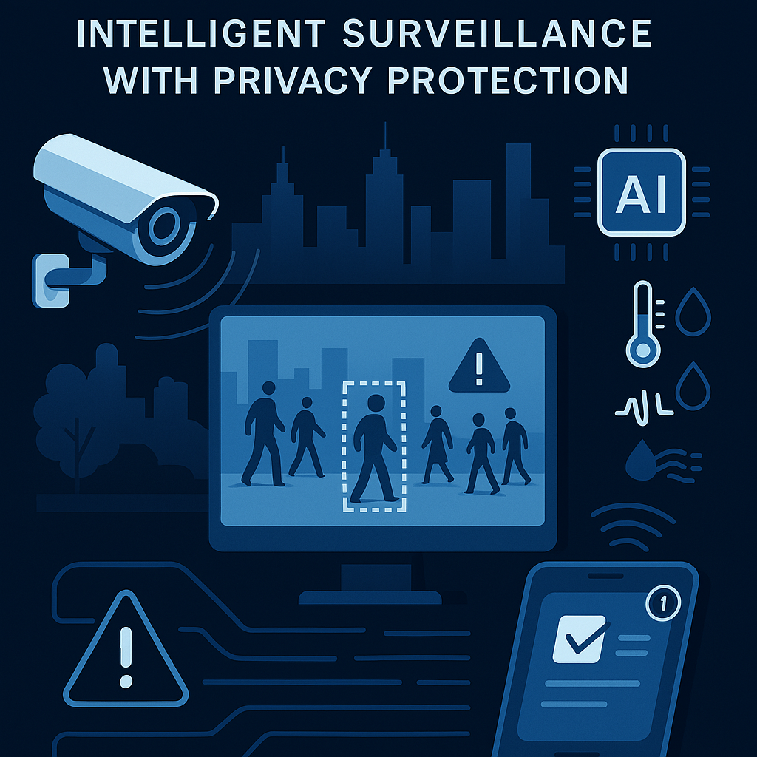
Our Solutions
3. Puplic security smart management
Edge AI processes data on-device, ensuring privacy.
Anomaly detection secures without personal identification.
Multimodal sensors offer comprehensive situational awareness.
Intelligent alerts prioritize incidents with efficient workflows.

Slide 14
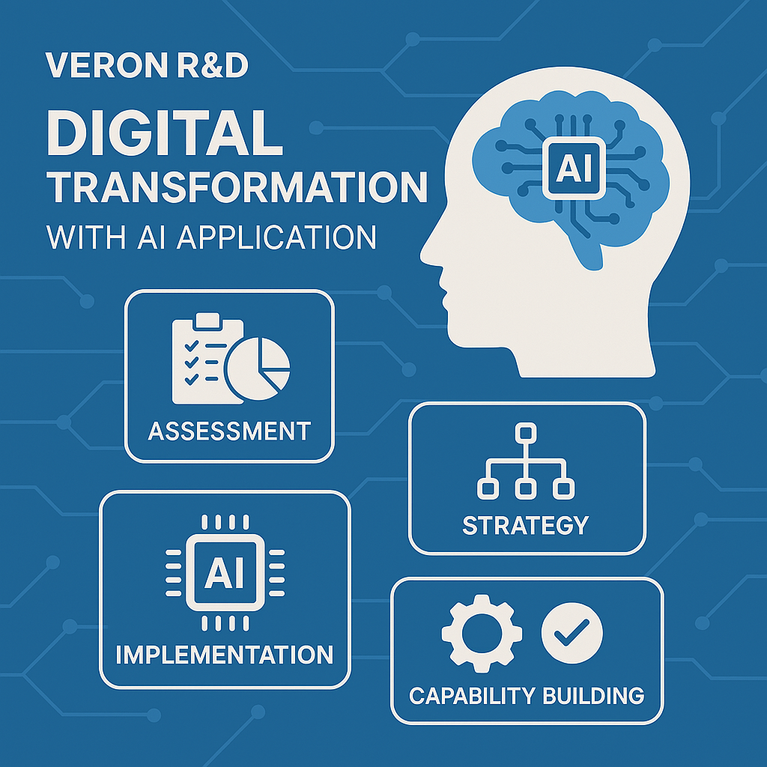
Our Solutions
4. Digital transformation with AI application
Evaluate digital maturity, infrastructure, and business goals.
Develop strategic roadmap aligning with operational priorities.
Deploy modular solutions using FPGA, SBC, and custom chips.
Accelerate AI development via modules, training, and governance.

Slide 15
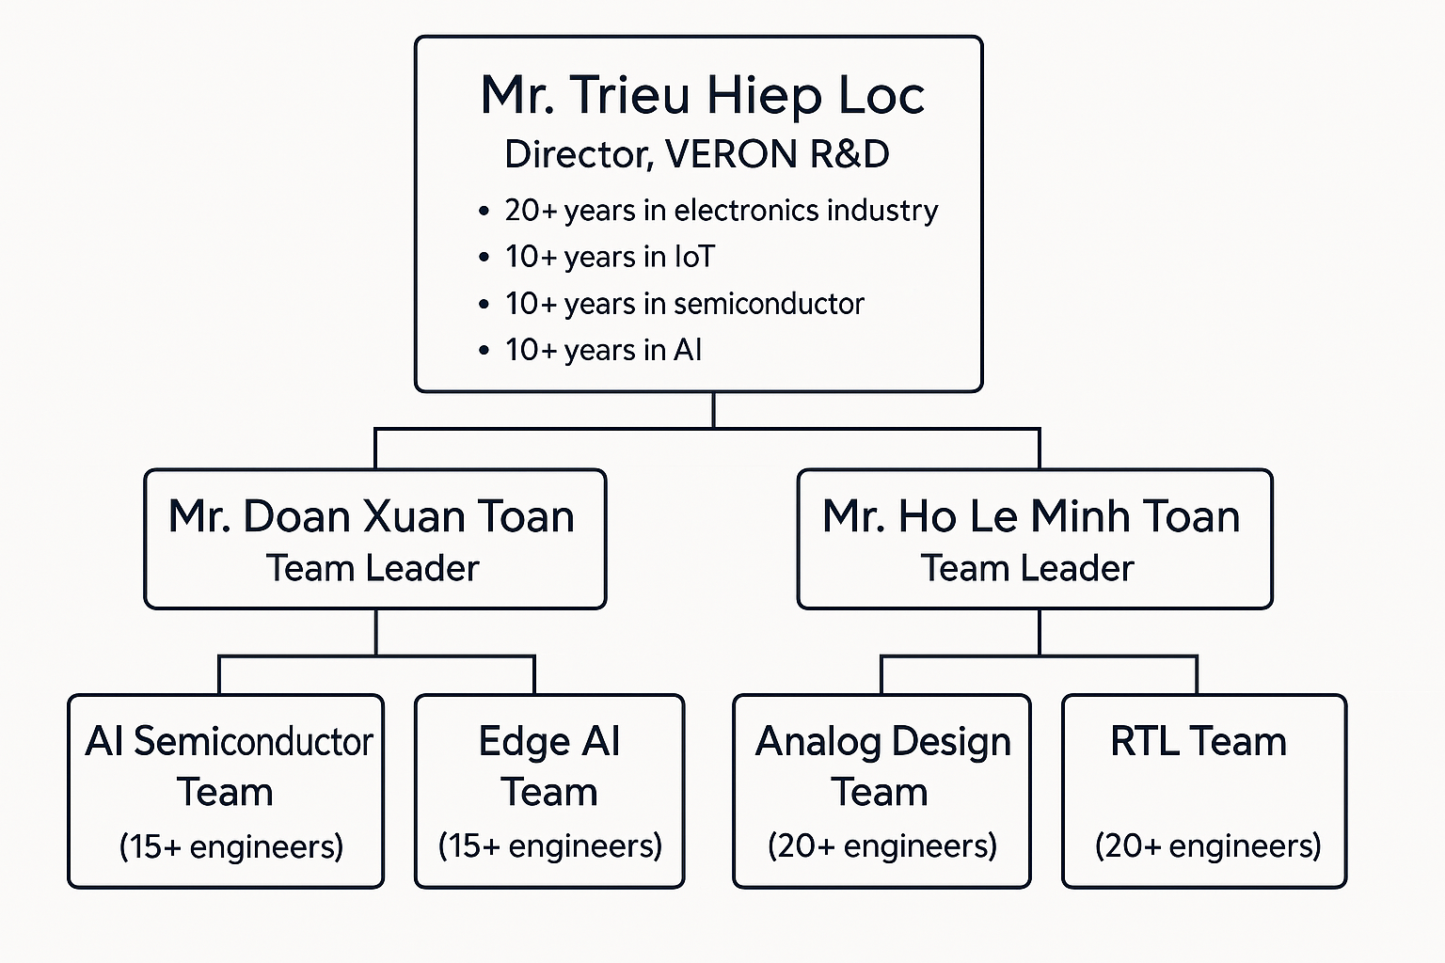
Our Experts

Slide 16
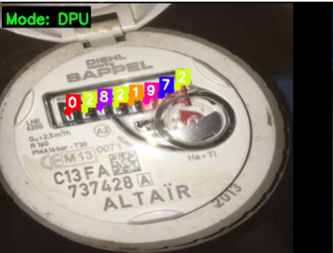
Our Experience
1. Water’s quality smart management system
Delivered year: In-Progress
Client: Confidential Information
Core technology: FPGA DPU Edge AI

Slide 17
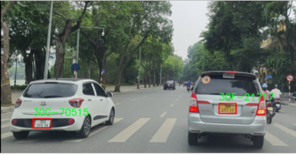
Our Experience
2. Traffic smart management system
Delivered year: In-Progress
Client: Confidential Information
Core technology: FPGA DPU Edge AI

Slide 18
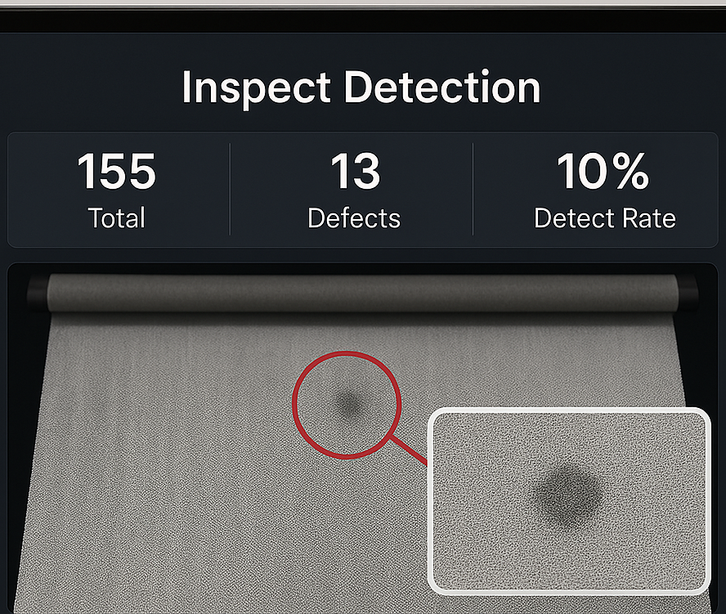
Our Experience
3. Intelligent quality management system for textile manufacturing plats
Delivered year: In-Progress
Client: Confidential Information
Core technology: SBC Edge AI

Slide 19
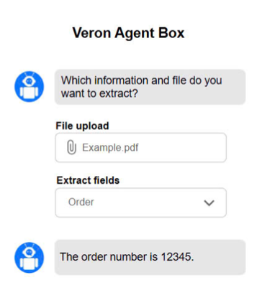
Our Experience
4. Intelligent records managements system
Delivered year: In-Progress
Client: Confidential Information
Core technology: FPGA DPU Edge AI

Slide 20
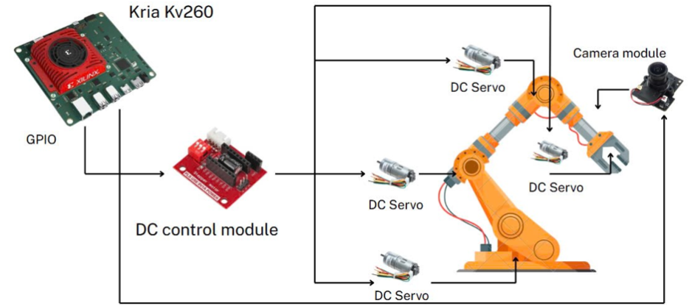
Our Experience
5. AI Brain for robotic arm system
Delivered year: In-Progress
Client: Confidential Information
Core technology: FPGA DPU Edge AI

Slide 21
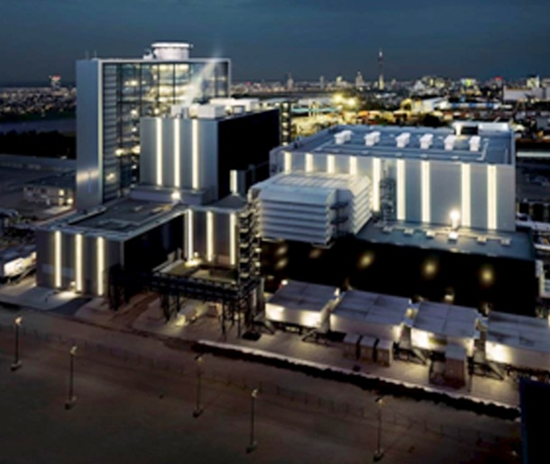
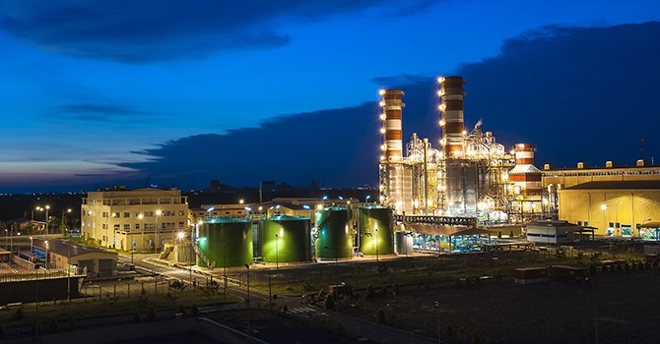
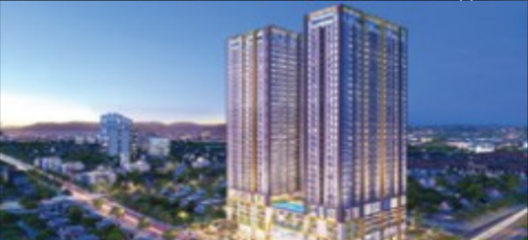
Our Experience
6. Other projects
Deploy an IoT system to manage machine data transmitted from the factory to the Senseye platform integrated with AI, aimed at analyzing current machine statuses, predicting potential issues, and proposing maintenance strategies.
Deploy an IoT system to manage environmental parameters from the factory, incorporating integrated AI for analysis, operation, and regulation of these parameters to ensure the safety of both products and production processes.
Deploy an IoT system to manage and monitor security and environmental conditions in offices and buildings for the Phu Dong Sky Garden luxury condominium project.

Slide 22

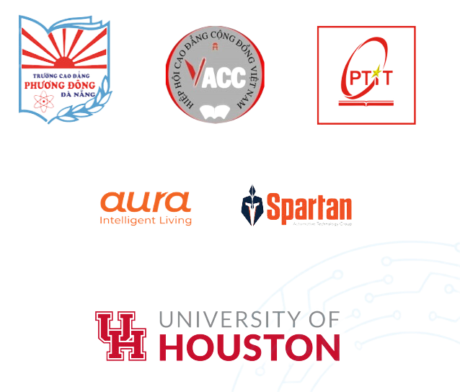
Our Partners

Slide 23
